Slide 1
Introduction to Simple Syllabus
Create…Submit…Share

Slide 2
Objectives
After completing this training, you will be able to:
Utilize Simple Syllabus to create a course syllabus using the SVCC Template
Send an edited syllabus for approval
Share the completed syllabus with students

Slide 3
What is Simple Syllabus?
Section I

Slide 4
Institution-wide Syllabus Solution
Simple Syllabus provides:
a standardized template for SVCC courses
pre-filled institutional policies and basic course information
a Streamlined syllabus approval process
A syllabus library where course syllabi can be viewed, shared, or downloaded as a pdf file
Integration within SVCC’s Canvas LMS

Slide 5
Benefits
Saves instructor time
Archives syllabi from previous semester
Consistent formatting helps students find information quickly
HTML versions are accessible to students with disabilities

Slide 6
Edit a Syllabus
Section II

Slide 7
Two Ways to Locate a Syllabus
Simple Syllabus web interface
SVCC Canvas LMS
Navigate to svcc.simplesyllabus.com
Select Dashboard
Select a syllabus
Log into svcc.edu/canvas
Select the course card from your Canvas dashboard
Select Simple Syllabus from the course navigation menu

Slide 8
Your Simple Syllabus Profile
Section 1

Slide 9
Create Your Profile
Save time by filling out your profile at Simple Syllabus.
Profile items will automatically fill in on every Simple Syllabus you create.
Navigate to svcc.simplesyllabus.com and select Profile from the upper right of the screen.

Slide 10
Create Your Profile, cont.
Fill out the following sections:
Simple Syllabus Screenshot
First name
Last name
Prefix
Suffix
Email address
Office Number (if applicable)
Office Telephone (if applicable)
Expectations of response to student email
Expectations of response time to grading assignments

Slide 11
Create Your Profile, cont. 2
Leave this section blank:
Simple Syllabus Profile: Office Hours
Office Hours
Office hours will be added manually to the course syllabus.
The manual option prevents a syllabus in production from overwriting office hours in a syllabus currently in use.
There is no need to update your password.

Slide 12
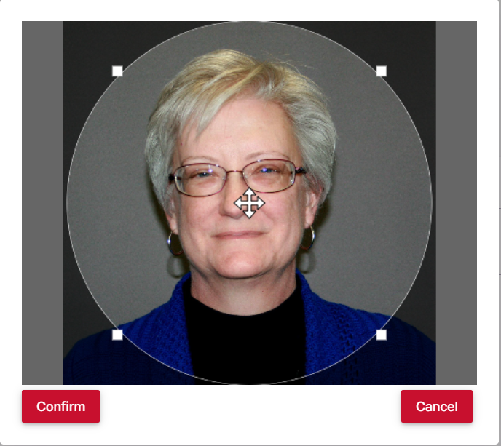
Optional Profile Items - Photo
Image 1
Upload a professional headshot to your profile.
Select Upload Headshot from the Profile form, as in image 1 at right.
Select a photo from files on your computer
Use the editing tools to center or resize the circle frame. See image 2.
Select Confirm. See image 2.
Image 2

Slide 13
Optional Profile Items – Video
Videos must include accurate, synchronized closed captions with punctuation and capitalization according to standard English grammar.
Upload or embed a welcome video:
Select the Insert Video Icon

Slide 14
Video Insertion - Embed
Locate and copy the embed code for the video in Panopto or YouTube
Select the Embedded Code icon in Simple Syllabus.
Paste the embed code in the provided box.
Select Insert.

Slide 15
Video Insertion - Upload
To upload a video, select the upload icon in Simple Syllabus.
Drag and drop the video to the provided box or click in the box and search your files to locate the video.

Slide 16
Save Profile
When you have completed your profile,
Select Save at the bottom left of the screen.

Slide 17
Editing the Syllabus
Section 2

Slide 18
Video: Editing
View a demonstration of the editing features in Simple Syllabus.

Slide 19
Section 1: Header
The Header includes:
SVCC logo
SVCC address
Course number and section
Course name
Semester designation
All Header items will autofill and require no editing.

Slide 20
Section 2: Course Information
Course information includes:
Class meeting location and times
Course delivery method
Number of Credit hours
ELA Requirement
Course information will autofill and no editing is required.

Slide 21
Section 3: Instructor Information
Instructor information provided in your Simple Syllabus Profile will autofill.
Select the red edit pencil to add office hour information.

Slide 22
Sections 4 - 6: Class Materials
Add Required materials, Recommended materials, and Optional materials:
Enter the title or isbn of the textbook in the search bar; scroll to find the correct item and click to add to syllabus.
For additional materials, enter the name of the item in the Title field.
Blank fields will not display to students.
Notes:
Another way to look at reflective thinking is demonstrated by Borton’s Cue Questions.

Slide 23
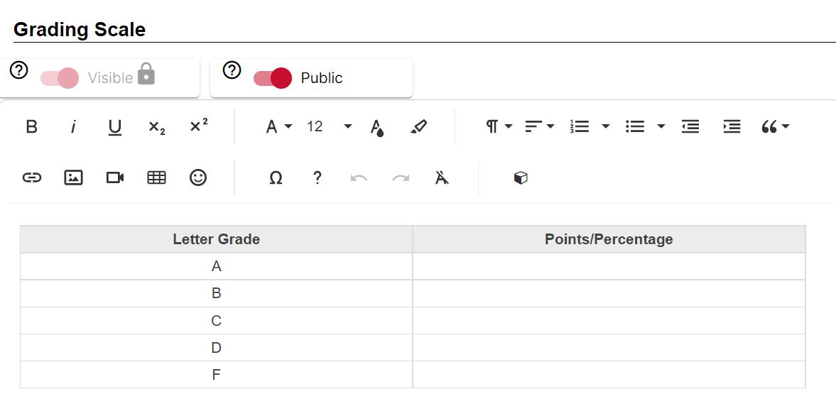
Section 7 - 9: Tables
The template provides formatted tables for the following:
Grading Methods and Evaluation
Grading Scale
Weekly/Daily Topical Schedule

Slide 24
Simple Syllabus Tables
Do not delete the table and attempt to substitute a table from MS Word or other software. It has been formatted to meet accessibility needs and conform to the SVCC template.
It is okay to copy and paste from another document to add data to individual cells.

Slide 25
Formatting Tables in Simple Syllabus
Place the cursor in any table row or column to access table editing tools.
Icons with a dropdown menu include a small arrow in the icon.
Select the Row icon to add or delete a row.
Select the Column icon to add or delete a column.
Choose either the vertical or Horizontal align icon to align text.
If you accidentally delete the Header row, select the first icon to replace the Header row. The Header row is required.
Important: Do not merge or split table cells.

Slide 26
Section 10: Course Objectives
Course objectives should be copied from the Course Outline word for word.
Copy and paste of the objectives from a Word document is possible, though some formatting will be necessary.

Slide 27
Section 11: Instructor Attendance Policy
Instructors are provided a text box to enter specifics of the attendance policy for the class.

Slide 28
Section 12: Instructor Make-up Policy
Instructors are provided a text box to enter specifics of the Make-up policy for the class.

Slide 29
Section 13: Additional Instructor Information
Instructors are provided an additional block to add other pertinent information of their choice.

Slide 30
SVCC Institution-wide Policies
SVCC’s Institutional policies are included in the template.
No editing is required.

Slide 31
Submit Syllabus
Scroll to the bottom of the page and select Submit when finished.
The syllabus will be reviewed.
If there are no issues, it will be approved.
If edits are required, you will be notified via your SVCC email account.

Slide 32
Viewing Options
Section 3

Slide 33
View in Syllabus Library
Users are able to see all of their course syllabi in one location by navigating to
svcc.simplesyllabus.com
and selecting the Syllabus Library tab.

Slide 34
View in Canvas
Users are able to view a course syllabus in Canvas by choosing Simple Syllabus from the course Navigation Menu.

Slide 35
Share via a link or embed code
Instructors are able to copy a direct link or embed code for sharing the syllabus at:
Svcc.simplesyllabus.com>Syllabus Library

Slide 36
Print a PDF Copy for Duplication
Instructors are able to download and print a PDF version of the syllabus for duplication at:
Svcc.simplesyllabus.com>syllabuslibrary

Slide 37
Preparing Your Syllabus in Subsequent Semesters
Section 4

Slide 38
Simple Syllabus is Sweeter the Second Time Around
In subsequent semesters, the most recent course syllabus will import automatically and should require significantly less time to edit.

Slide 39
Replace Syllabus
To replace the preloaded syllabus with a different syllabus, select the Term of the desired syllabus from the drop down menu or use the search bar to enter the name of the preferred syllabus.
Instructors will only be able to view their own past syllabi.

Slide 40
Thank You!
Thank you for viewing this training.
If you have questions, please direct them to:
Robin Fisch, SVCC Instructional Designer
robin.l.fisch@svcc.edu
815-8356318

